Slide 1

RUNGTA COLLEGE OF DENTAL SCIENCES & RESEARCH
TITLE OF THE TOPIC :
IMPRESSIONS FOR COMPLETE DENTURE Part two
DEPARTMENT OF PROSTHODONTICS AND CROWN & BRIDGE

Slide 2
Specific learning Objectives
At the end of this presentation the learner is expected to know ;
Core areas* | Domain ** | Category #
Introduction | Cognitive | Must know
Definition | Cognitive | Must know
Objectives of impression making | Cognitive | Must know
Theories of Impressions | Cognitive | Must know
Classifications of impression techniques | Cognitive | Must know
Advantages disadvantages | Cognitive | Must know
Summary | Cognitive | Must know
Take Home Message | Cognitive | Must know
Reference | Affective | Must know

Slide 3
Table of Content
Introduction
Definition
Objectives of impression making
Theories of Impressions
Classifications of impression techniques
Advantages disadvantages

Slide 4
SELECTION OF THE IMPRESSION TRAY
A device that is used to carry, confine, and control impression material while making an impression (GPT-8).
Classification of impression trays
Bases on whether they are prefabricated or individualized
Stock trays
Custom trays

Slide 5
Depending on the presence or absence of holes or perforations
Perforated
Non-perforated
Depending on whether they are meant for dentate or edentate individuals
Dentulous trays
Edentulous trays
Combination trays

Slide 6
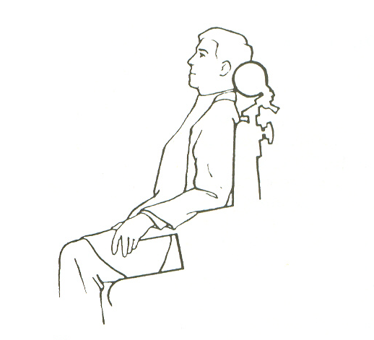
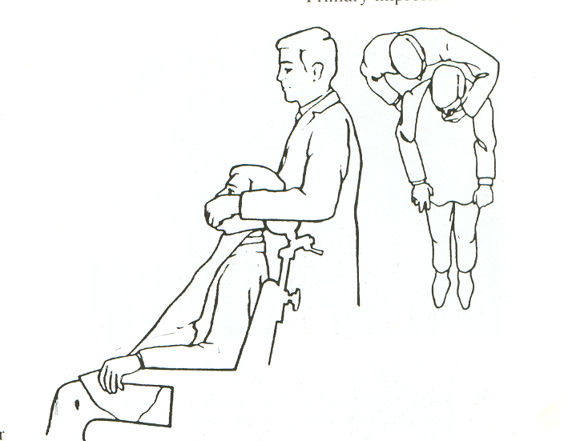
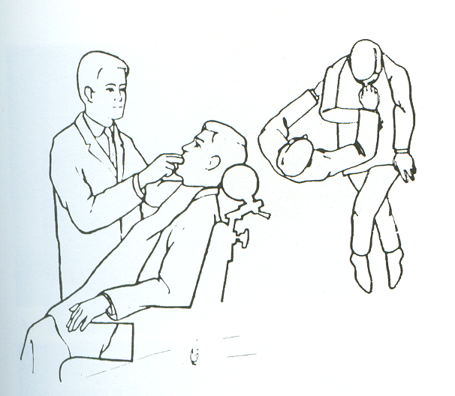
Seating of the patient
Position of the operator for maxillary impression
Position of the operator for mandibular impression

Slide 7
Preliminary impression making :Maxillary
Practice positioning of the tray
Labial frenum - guide.
Anterior fingers - 1st molar region
Adhesive - silicone putty material or alginate
Impression compound
Posterior part of tray- contact with tissues

Slide 8
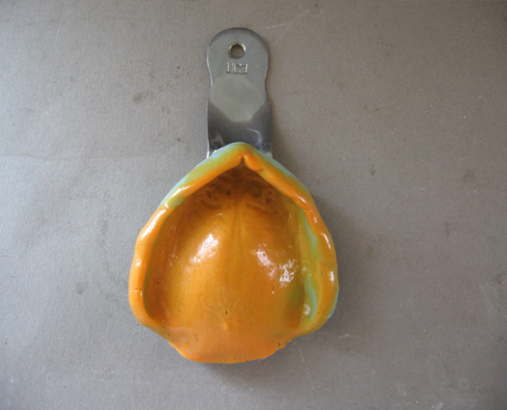
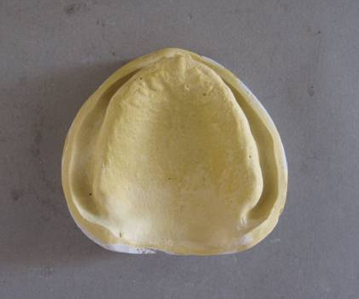
Border moulding
Labial and buccal vestibules
Coronoid process
Impression poured - stone

Slide 9
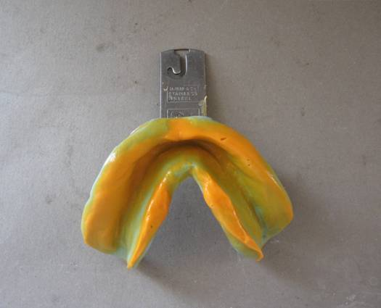
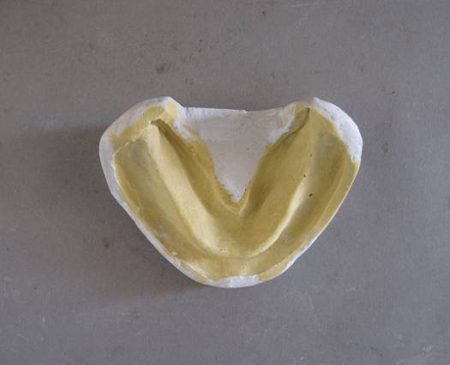
Primary impression : Mandibular
Posterior extent of tray – retromolar pad
Tray loaded with material and catered over the ridge with tongue slightly raised
Alternating pressure on molar region with index finger
Functional movements done to get the border limit

Slide 10
Constructing the custom tray
Outline for the wax spacer is drawn on the cast
Posterior palatal seal area on the cast is not covered with the wax spacer – maxilla
Buccal shelf not covered - mandible
Baseplate wax approximately 1 mm in thickness is placed on the cast
Self-curing acrylic resin tray material - uniformly adapted over the cast
Tray thickness - 2 to 3 mm
Resin handle is attached in the anterior region of the tray

Slide 11
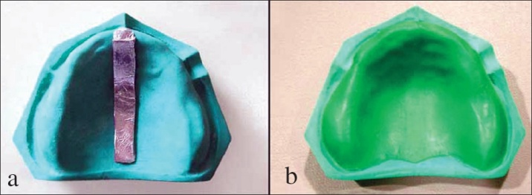
Spacer design
Roy Mac Gregor recommends placement of a sheet of metal foil in the region of incisive papilla and mid palatine raphae

Slide 12
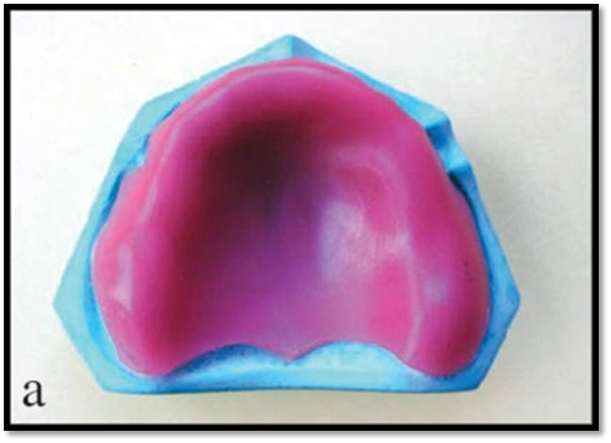
Neill recommends adaptation of 0.9 mm casing wax all over except PPS area
Boucher recommends placement of 1 mm base plate wax on the cast except PPS area

Slide 13
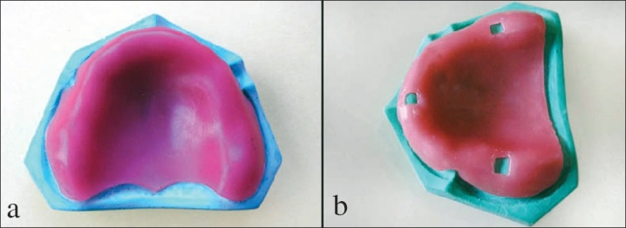
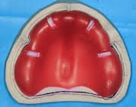
Morrow, Rudd, Rhoads recommends to block out undercut areas with wax ,adapt full wax spacer 2 mm short of resin special tray border all over & placement of 3 tissue stops equidistant from each other
Sharry recommended Base plate wax adapted over whole area, four stops 2mm width cut from wax : cuspid and molar region- extend from palatal aspect of ridge : mucobuccal fold

Slide 14
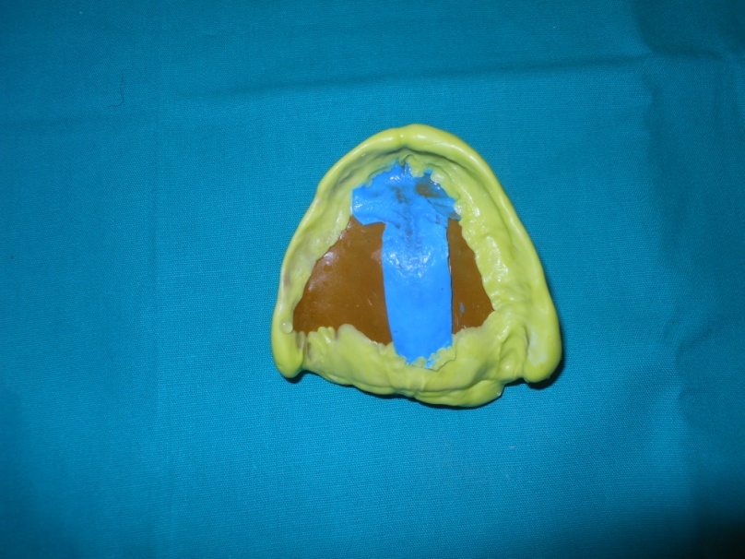
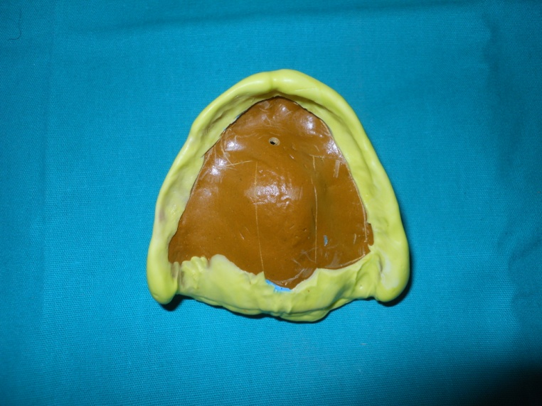
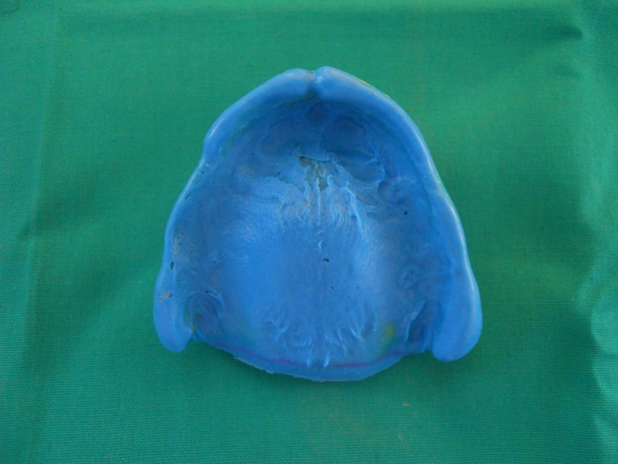

Slide 15
Border molding
Border molding is the process by which the shape of the borders of the tray is made to conform accurately to the contours of the buccal and labial vestibules
Manipulation of the border tissues, against a moldable impression material
Borders of the tray are molded to a form that will be in harmony with the physiological action of the limiting anatomical structures

Slide 16
Border molding may be carried out in sections either recording one part of the border at a time or recording all parts of the borders simultaneously.
Recording all of the borders simultaneously has two general advantages:
  The number of insertions of tray is reduced.
  Developing all borders simultaneously avoids propagation of errors caused by a mistake in one section affecting the borders contours in another.

Slide 17
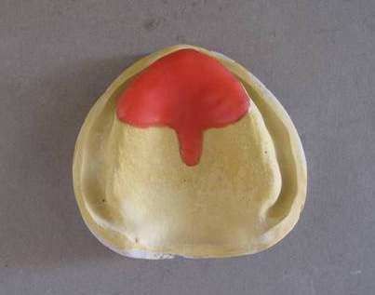
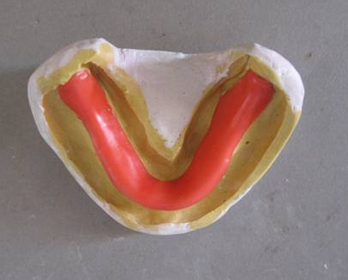
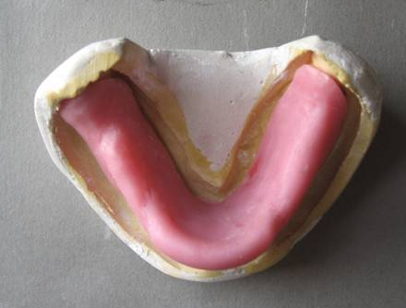
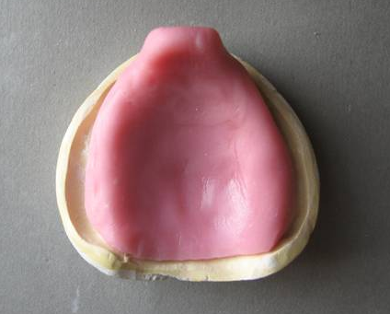
Custom tray fabrication

Slide 18
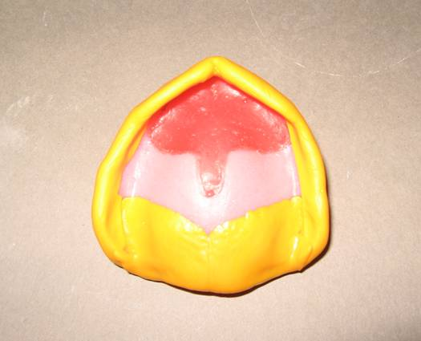
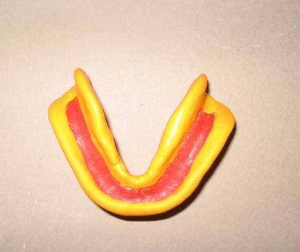
Border moulding
Sectional
Recording all borders simultaneously

Slide 19
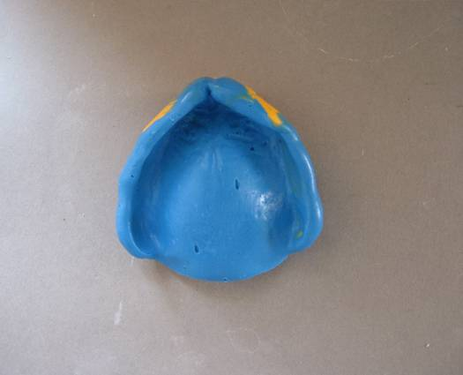
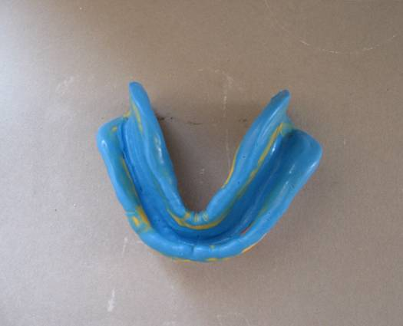
Final impressions

Slide 20
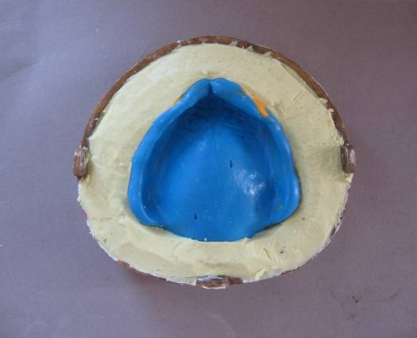
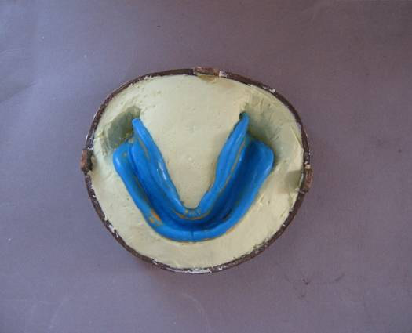
Boxing impressions and making casts
Enclosure of an impression by building up vertical walls- desired size, base of cast, preserve details of impression

Slide 21
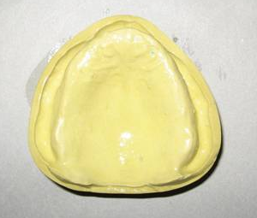
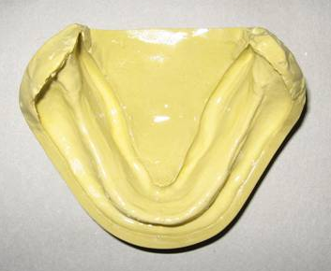
Final cast

Slide 22
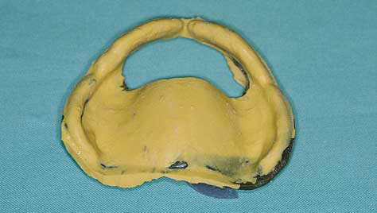
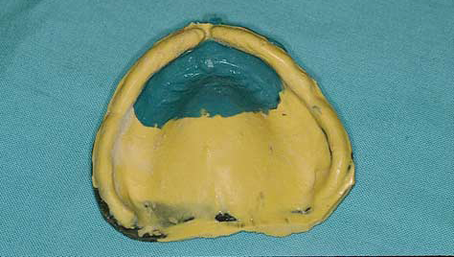
Displaceable (flabby) anterior maxillary ridge
The extent of the displaceable tissue is drawn on the impression surface. This area, and the equivalent area of the tray, are then removed, using a scalpel and acrylic bur
Use a low-viscosity material and paint or syringe these onto the displaceable tissue to record them in a minimally-displaced position.

Slide 23
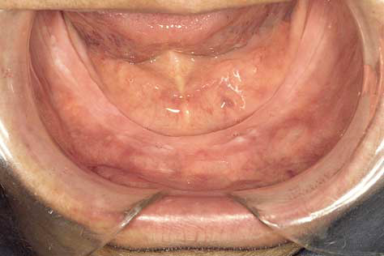
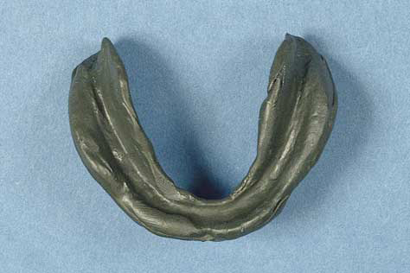
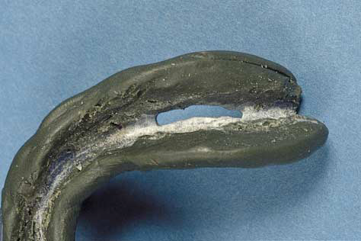
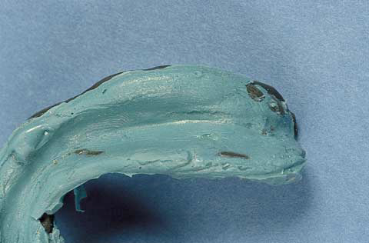
Fibrous posterior mandibular ridge
McCord.JF ,Grant.AA ,Impression making, BDJ, 2000 ;188: 9, pp 484 – 92

Slide 24
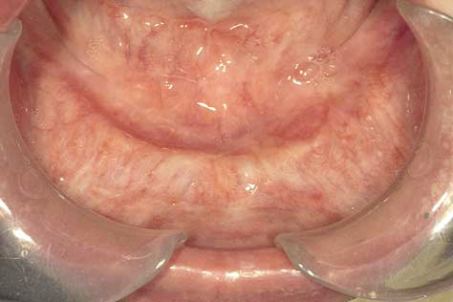
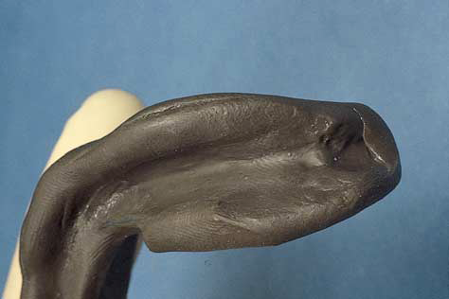
Flat (atrophic) mandibular ridge covered with atrophic mucosa
McCord and Tyson described this technique
The impression medium here is an admix of 3 parts by weight of (red) impression compound to 7 parts by weight of greenstick; the admix is created.
McCord.JF ,Grant.AA ,Impression making, BDJ, 2000 ;188: 9, pp 484 – 92

Slide 25
Technique for Impressing Class IV Mandibular Edentulous Ridge
Chandrasekharan et al, A Technique for Impressing the Severely Resorbed Mandibular Edentulous Ridge, Journal of Prosthodontics, 2012; 21: 215–218

Slide 26
Review of literature
Study evaluated changes in impression pressure produced by different types of relief space and escape holes in the impression tray for making an impression of a simulated maxillary edentulous arch
For making impressions of an edentulous maxilla, the data suggest that a tray with an escape hole
1.0 mm or larger or a spacer thickness of base plate wax (1.40 mm) be used.
Komiyama O et al, Effects of relief space and escape holes on pressure characteristics of maxillary edentulous impressions, J Prosthet Dent 2004;91:570-6

Slide 27
Goodacre et al, CAD/CAM fabricated complete dentures: concepts and clinical methods of obtaining required morphological data, J Prosthet Dent 2012;107:34-46

Slide 28
Infante et al, Fabricating complete dentures with CAD/CAM technology, J Prosthet Dent 2014

Slide 29
TAKE HOME MESSEGE /
FOR THE TOPIC COVERED (SUMMARY)
“Ideal impression must be in the mind of the dentist before it is in his hand. He must literally make the impression rather than take it”
- M.M. De van

Slide 30
References
Zarb G, Hobkirk JA, Eckert SE, Jacob RF, editors. Prosthodontic treatment for edentulous patients. 13th ed. St. Louis: Elsevier Mosby; 2013 pp 161-179
Sheldon Winkler, Essentials of complete Denture prosthodontics, 2nd edition,2012, AITBS Publishers, India, pp 88-105
Sharry .J.J, Complete denture Prosthodontics, 3rd edition, Mc Graw Hill company, pp 191-210.
Rudd and Morrow, Dental lab procedures, Complete dentures, 2nd edition, 1986, Mosby Publications, USA, Pp 9 - 89
Nair KC, A primer on complete denture fabrication, 1st edition, 2013, Ahuja publication, India Pp 67-77
Zimmer I.D. and Sherman, H. An analysis of the development of complete denture impression techniques. J Prosthet dent 46: 242-249, 1981.
Komiyama O et al, Effects of relief space and escape holes on pressure characteristics of maxillary edentulous impressions, J Prosthet Dent 2004;91:570-6

Slide 31
References
McCord.JF ,Grant.AA ,Impression making, BDJ, 2000 ;188: 9, pp 484 – 92
Rao.S etal, A Systematic Review of Impression Technique for Conventional Complete Denture, J Indian Prosthodont Soc (Apr-June 2010) 10(2):105–111
Chandrasekharan.NK et al, A Technique for Impressing the Severely Resorbed Mandibular Edentulous Ridge, Journal of Prosthodontics, 2012; 21: 215–218
Goodacre et al, CAD/CAM fabricated complete dentures: concepts and clinical methods of obtaining required morphological data, J Prosthet Dent 2012;107:34-46
Infante et al, Fabricating complete dentures with CAD/CAM technology,J Prosthet Dent 2014
Dwivedi A, Vyas R, Theories of impression making and their rationale in complete denture prosthodontics. J Orafac Res 2013;3(1):34-37

Slide 32
THANK YOU

